Slide 1
From MITRE ATT&CK to SPARTA 1.MITRE ATT&CK
崑山科技大學 雲端運算暨資通安全研發中心主任
指導老師:曾龍
學生:董宸維

Slide 2
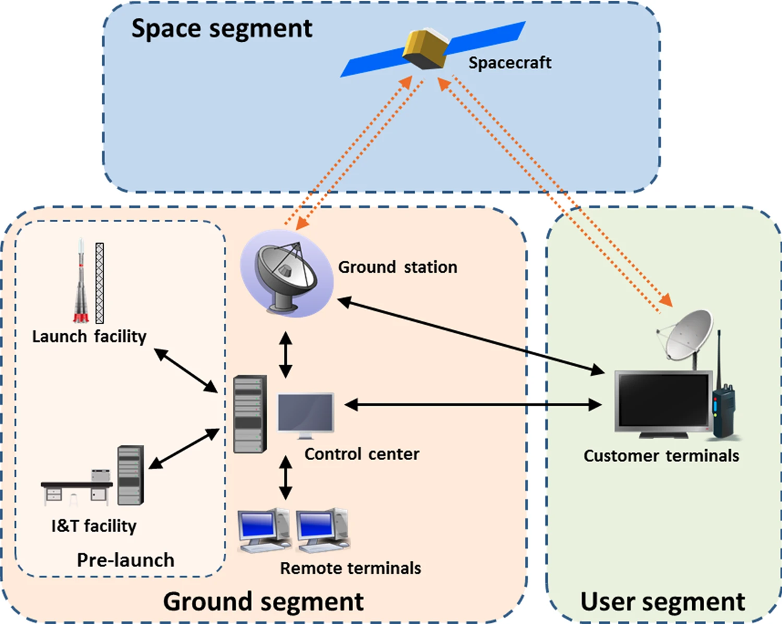
Threat Modelling 威脅建模
Attack Tree攻擊樹
Stride | DREAD
Cyber Killing Chain
MITRE ATTACK

Slide 3
Threat Modelling威脅建模: Stride | DREAD
https://zh.wikipedia.org/zh-tw/STRIDE
STRIDE是微軟的Praerit Garg和Loren Kohnfelder建立的威脅模型
目的是在找出電腦安全上的威脅。 是六種安全威脅分類英文的字首組成
STRIDE一開始是設計作為威脅模型分析程序的部份。STRIDE是威脅模型，讓分析者可以理解威脅系統的方式，並設法找出威脅。
STRIDE可以和目標系統的模型一起使用。分析過程會將程序、資料儲存、資料流及信任邊界（Trust boundaries）進行完整的拆解。
安全專家會用STRIDE來回答這個問題：「目前運作的系統中，哪些地方可能會有問題？」
每一個的威脅都會影響理想的系統屬性
Property屬性 | Threat | 定義 | 範例
驗證 Authentication | 欺騙 Spoofing | 冒充某物或他人。 | 冒充 billg、microsoft.com 或 ntdll.dll 中的任何一個
完整性 Integrity | 篡改_ Tampering | 修改數據或代碼 | 修改磁盤或 DVD 上的 DLL，或在數據包穿越 LAN 時修改數據包。
不可否認性 Non-repudiation | 否認_ Repudiation | 聲稱沒有採取任何行動。 | “我沒有發送那封電子郵件，” “我沒有修改那個文件，”
保密 Confidentiality | 信息披露 Information Disclosure | 向未經授權查看信息的人公開信息 | 允許某人閱讀 Windows 源代碼；將客戶列表發佈到網站。
可用性 Availability | 拒絕服務 Denial of Service | 拒絕或降低向用戶提供的服務 | 使 Windows 或網站崩潰、發送數據包並佔用數秒的 CPU 時間，或者將數據包路由到黑洞。
授權 Authorization | 特權提升 Elevation of Privilege | 未經適當授權就獲得能力 | 允許遠程互聯網用戶運行命令是一個典型的例子，但從受限用戶到管理員也是 EoP。
https://learn.microsoft.com/en-us/azure/security/develop/threat-modeling-tool-threats

Slide 4
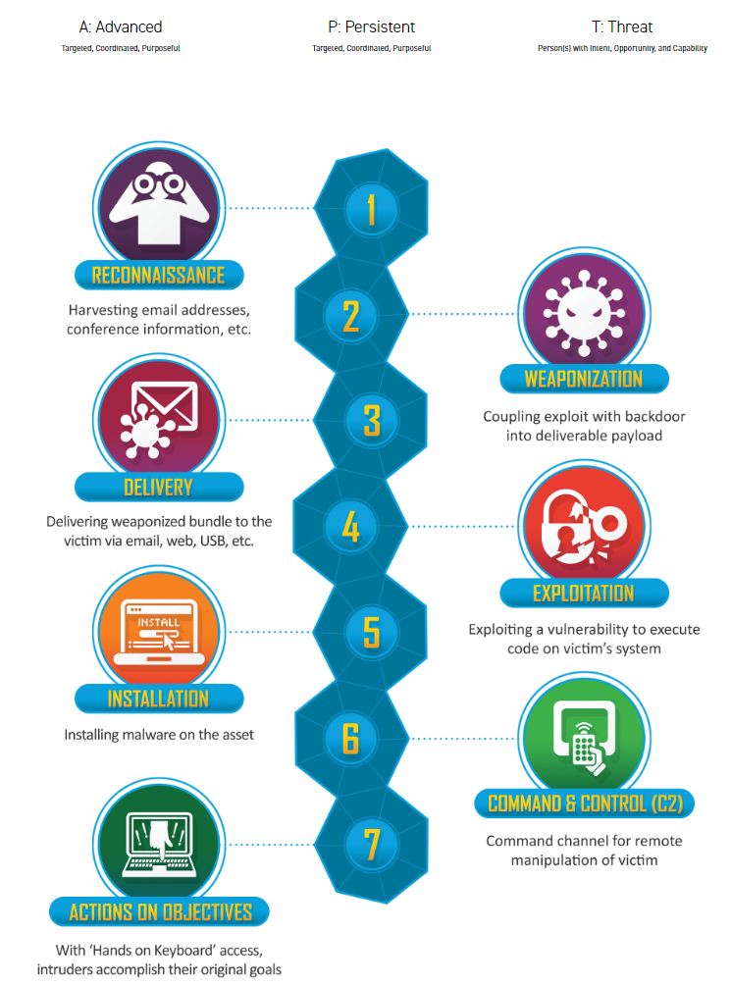
Cyber Killing Chain
https://www.lockheedmartin.com/en-us/capabilities/cyber/cyber-kill-chain.html
https://en.wikipedia.org/wiki/Kill_chain
網路攻擊鏈(Cyber Kill Chain) 7個環節
1.偵查 Reconnaissance | 攻擊者收集目標對象的資料，如電子郵件信箱、社群平台的資料，以找到可以下手的弱點；或是透過工具，掃描目標對象的網站、系統，得知使用的系統種類、版本
2.武裝 Weaponization | 攻擊者使用現成的開源工具或是自行開發專屬的惡意程式
3.遞送 Delivery | 攻擊者將攻擊武器送入目標的系統內，如透過釣魚信件裡的連結、夾帶木馬的盜版軟體、隨身碟
4.漏洞利用 Exploitation | 確保遞送的惡意軟體，藉由目標對象的系統漏洞，得以順利開啟，並使攻擊者獲得控制權
5.安裝 Installation | 攻擊者確保自身可以長期控制目標的系統內，以有足夠的時間進行後續環節
6.發令與控制 Command & Control | C2 攻擊者潛伏在目標的系統內，收集資料，探索環境，以便審慎規劃後續行動。
7.行動 Actions | 根據攻擊者的最終目標，採取行動，如破壞系統、竊取機密資料、勒索目標對象
https://teamt5.org/tw/posts/what-is-cyber-kill-chain/

Slide 5
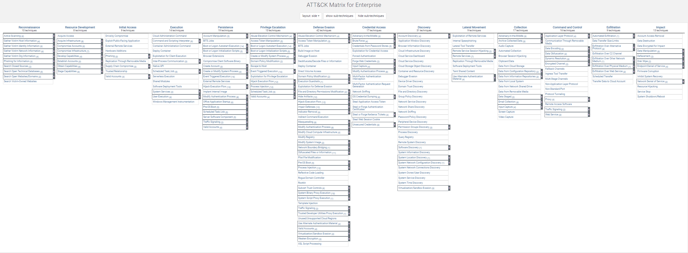
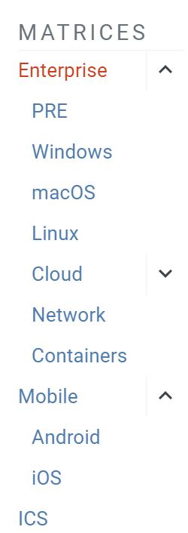

資安威脅趨勢 MiTRE Att@ck
https://attack.mitre.org/
https://go.crowdstrike.com/rs/281-OBQ-266/images/CrowdStrike2023GlobalThreatReport.pdf

Slide 6
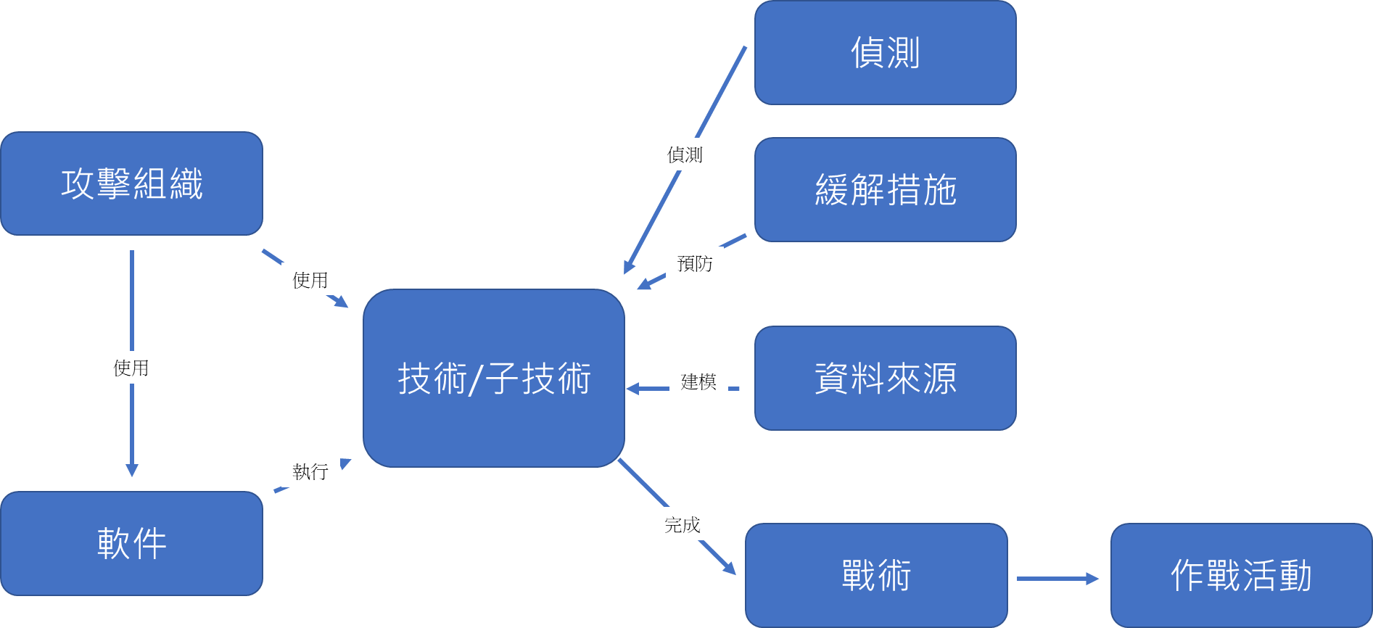

Slide 7
Tactics(戰術), Techniques, and Procedures (TTP) 用以描述威脅行動者的攻擊模式或特徵 一份有價值的威脅情資報告會提供詳盡的 TTPs 分析，協助使用者深入了解該次攻擊事件，從而採取正確的防禦措施
戰術(tactic) | 以宏觀層次描述描述網路攻擊
技巧(technique): | 比戰術的細節更多，提供完整的脈絡
程序(procedure): | 說明完整的攻擊過程，較技巧所提供的資訊更詳細
Tactics戰術(Techniques技巧數目)
1.偵察Reconnaissance(10)
2.資源開發Resource Development(8)
3.初步存取 Initial Access(9)
4.執行Execution(14)
5.持續性Persistence(19)
6.權限提升Privilege Escalation (13)
7.閃避掉防禦機制 Defense Evasion(42)
8.存取憑證 Credential Access(17)
9.發現Discovery(31)
10.橫向移動Lateral Movement(9)
11.收集Collection(17)
12.命令與控制Command and Control(16)
13.外洩Exfiltration(9)
14.衝擊Impact(13)
https://csrc.nist.gov/glossary/term/tactics_techniques_and_procedures
https://teamt5.org/tw/posts/what-are-tactics-techniques-and-procedures-ttps/
。

Slide 8
1.偵察Reconnaissance戰術的10大類型技術(Techniques)
1.主動掃描 Active Scanning(3)
2.收集受害者主機資料Gather Victim Host Information(4)
3.收集受害者身份資料 Gather Victim Identity Information(3)
4.收集受害者網路資料Gather Victim Network Information(6)
5.收集受害者組織資料 Gather Victim Org Information(4)
6.使用網路釣魚獲取資料 Phishing for Information(3)
7.搜索閉源Search Closed Sources(2)
8.搜索開放技術資料庫Search Open Technical Databases(5)
9.搜索開放的網站/網域 Search Open Websites/Domains(3)
10.搜索受害者擁有的網站Search Victim-Owned Websites

Slide 9
1.偵察Reconnaissance 戰術
1.收集受害者網路訊息 Gather Victim Network InformationT1590 (6)技術
Adversaries(攻擊者)可能會收集有關受害者網路的信息，這些資訊可在瞄準期間使用。
有關網路的資訊可能包括各種詳細信息
包括管理資料（例如：IP 範圍、網域名稱等）
以及有關其拓撲和操作的細節。
Adversaries可以透過各種方式收集這些信息，
例如透過主動掃描或網路釣魚資訊進行直接收集操作。
有關網路的資訊也可能透過線上或其他可存取的資料集
（例如：搜尋開放技術資料庫）暴露給對手。
收集此資訊可能會揭示其他形式的偵察機會
（例如：主動掃描或搜尋開放網站/網域）、
建立營運資源（例如：取得基礎設施或破壞基礎設施）
或初始訪問（例如：信任關係）。
ID: T1590
Sub-techniques: T1590.001, T1590.002, T1590.003
T1590.004, T1590.005, T1590.006
Tactic: Reconnaissance
Platforms: PRE
Version: 1.0
Created: 02 October 2020
Last Modified: 15 April 2021
Sub-techniques (6)
ID | Name
T1590.001 | Domain Properties
T1590.002 | DNS
T1590.003 | Network Trust Dependencies
T1590.004 | Network Topology
T1590.005 | IP Addresses
T1590.006 | Network Security Appliances
Information about networks may also be exposed to
adversaries via online or other accessible data sets
(ex: Search Open Technical Databases).
Gathering this information may reveal opportunities for
other forms of reconnaissance
(ex: Active Scanning or Search Open Websites/Domains),
establishing operational resources
(ex: Acquire Infrastructure or Compromise Infrastructure),
and/or initial access (ex: Trusted Relationship).

Slide 11
1.偵察Reconnaissance 戰術| 1.主動掃描 Active ScanningT1595 (3)技術
Adversaries(攻擊者)可能會執行主動掃描(Active Scanning)來收集可在瞄準期間使用的資料。
主動掃描是Adversaries通過網路探測受害者基礎設施的掃描，而不是其他不涉及直接交互的偵察形式
Adversaries可能會根據他們要收集的資料執行不同形式的主動掃描。
這些掃描也可以通過多種方式執行，包括使用 ICMP 等網路協議的本機功能。
來自這些掃描的資料可能會提供給其他形式的偵察機會(例如：搜索開放網站/域或搜索開放技術資料庫)、建立運營資源(例如：開發能力或獲得能力)和/或初始訪問(例如：外部遠程服務或利用面向公眾的應用程序) Information from these scans may reveal opportunities for other forms of reconnaissance (ex: Search Open Websites/Domains or Search Open Technical Databases), establishing operational resources (ex: Develop Capabilities or Obtain Capabilities), and/or initial access (ex: External Remote Services or Exploit Public-Facing Application).
ID: T1595
Sub-techniques: T1595.001, T1595.002, T1595.003
Tactic: Reconnaissance
Platforms: PRE
Version: 1.0
Created: 02 October 2020
Last Modified: 08 March 2022
Sub-techniques (3)
ID | Name
T1595.001 | Scanning IP Blocks
T1595.002 | Vulnerability Scanning
T1595.003 | Wordlist Scanning

Slide 12
1.偵察Reconnaissance 戰術| 1.主動掃描 Active ScanningT1595 (3)技術
Mitigations 緩解措施
ID | Mitigation | Description
M1056 | Pre-compromise | This technique cannot be easily mitigated with preventive controls since it is based on behaviors performed outside of the scope of enterprise defenses and controls. 這種技術無法通過預防性控制輕鬆緩解，因為它基於在企業防禦和控制範圍之外執行的行為。 Efforts should focus on minimizing the amount and sensitivity of data available to external parties.應重點努力最大限度地減少外部各方可用數據的數量和敏感性。
Detection偵測
ID | Data Source | Data Component | Detects
DS0029 | Network Traffic 網絡流量 | Network Traffic Content 網絡流量內容 | Monitor and analyze traffic patterns and packet inspection associated to protocol(s) that do not follow the expected protocol standards and traffic flows (e.g extraneous packets that do not belong to established flows, gratuitous or anomalous traffic patterns, anomalous syntax, or structure). 監視和分析與不遵循預期協議標準和流量的協議相關的流量模式和數據包檢查（例如，不屬於已建立流的無關數據包、無償或異常流量模式、異常語法或結構）。 Consider correlation with process monitoring and command line to detect anomalous processes execution and command line arguments associated to traffic patterns (e.g. monitor anomalies in use of files that do not normally initiate connections for respective protocol(s)).考慮與進程監控和命令行的相關性，以檢測與流量模式關聯的異常進程執行和命令行參數（例如，監控通常不為相應協議啟動連接的文件使用中的異常情況）。
 |  | Network Traffic Flow | Monitor network data for uncommon data flows. 監視網路數據中不常見的數據流。 Processes utilizing the network that do not normally have network communication or have never been seen before are suspicious. 使用通常沒有網絡通信或以前從未見過的網絡的進程是可疑的。

Slide 13
資料加密衝擊 Data Encrypted for Impact
https://attack.mitre.org/techniques/T1486/
Adversaries(攻擊者)可能會對目標系統或網路中大量系統上的資料進行加密，以中斷系統和網路資源的可用性。
Adversaries(攻擊者)可以嘗試通過加密本地和遠程驅動器上的文件或資料並禁止訪問解密密鑰來使存儲的資料無法訪問。這樣做可能是為了從受害者那裡獲取金錢補償，以換取解密或解密密鑰（勒索軟件），或者在密鑰未保存或傳輸的情況下使資料永久無法訪問。
對於勒索軟件，Office 文檔、PDF、圖像、視頻、音頻、文本和源代碼文件等常見用戶文件通常會被加密（並且通常會被重命名和/或標記為特定文件標記）。
對手可能需要首先採用其他行為，例如文件和目錄權限修改或系統關閉/重啟，以便解鎖和/或獲得操作這些文件的權限。
在某些情況下，對手可能會對關鍵系統文件、磁盤分區和 MBR 進行加密。
為了最大程度地影響目標組織，設計用於加密資料的惡意軟件可能具有類似蠕蟲的功能，可以通過利用其他攻擊技術（如有效帳戶、操作系統憑據轉儲和SMB/Windows 管理共享）在網路中傳播。
加密惡意軟件還可能利用內部損壞，例如更改受害者壁紙，或通過向連接的打印機發送贖金票據或其他訊息（稱為“打印轟炸”）來恐嚇受害者。
在雲環境中，受感染帳戶中的存儲對像也可能被加密

Slide 14
Procedure Examples 攻擊情境
ID | Name | Description
G0082 | APT38 | APT38 has used Hermes ransomware to encrypt files with AES256.
G0096 | APT41 | APT41 used a ransomware called Encryptor RaaS to encrypt files on the targeted systems and provide a ransom note to the user.
 |  | ……………………………………………….
Mitigations緩解措施
ID | Mitigation | Description
M1040 | Behavior Prevention on Endpoint | On Windows 10, enable cloud-delivered protection and Attack Surface Reduction (ASR) rules to block the execution of files that resemble ransomware.
M1053 | Data Backup | Consider implementing IT disaster recovery plans that contain procedures for regularly taking and testing data backups that can be used to restore organizational data. Ensure backups are stored off system and is protected from common methods adversaries may use to gain access and destroy the backups to prevent recovery. Consider enabling versioning in cloud environments to maintain backup copies of storage objects.

Slide 15
Detection偵測
ID | Data Source | Data Component | Detects
DS0010 | Cloud Storage | Cloud Storage Modification | Monitor for changes made in cloud environments for events that indicate storage objects have been anomalously modified.
DS0017 | Command | Command Execution | Monitor executed commands and arguments for actions involved in data destruction activity, such as vssadmin, wbadmin, and bcdedit
DS0022 | File | File Creation | Monitor for newly constructed files in user directories.
 |  | File Modification | Monitor for changes made to files in user directories.
DS0033 | Network Share | Network Share Access | Monitor for unexpected network shares being accessed on target systems or on large numbers of systems.
DS0009 | Process | Process Creation | Monitor for newly constructed processes and/or command-lines involved in data destruction activity, such as vssadmin, wbadmin, and bcdedit.

Slide 16
 | 1. | 關於 MITRE ATT&CK 中的網路服務阻斷(Network Denial of Service)技術(Technique)對策，下列何項錯誤？ 可分析應用程式日誌(Application Log)內容來偵測 此技術 可觀察網路流量(Network Traffic)狀態來偵測此技 術 可觀察感應器健康(Sensor Health)狀態來偵測此技 術 可透過網路流量過濾(Filter Network Traffic)來緩 解此技術
 | 2. | 關於 MITRE ATT&CK 中的資料加密衝擊(Data Encrypted for Impact)技術對策，下列何項錯誤？ 可透過資料備份(Data Backup)來緩解此技術 可觀察感應器健康狀態(Sensor Health)來偵測此技 術 可透過端點行為預防(Behavior Prevention on Endpoint)來緩解此技術 可觀察檔案建立(File Creation)與修改(File Modification)狀態偵測此技術
 | 3. | 關於MITRE ATT&CK 中的橫向移動（Lateral Movement）戰術（Tactic），下列何項錯誤？ (A) 遠端服務破解（Exploitation of Remote Services）屬於此類戰術 (B) 內部魚叉釣魚（Internal Spearphishing）屬於此類戰術 (C) 橫移工具傳輸（Lateral Tool Transfer）屬於此類戰術 (D) 本地資料取得（Data from Local System）屬於此類戰術
 | 4. | 關於MITRE ATT&CK 中的輸入擷取（Input Capture）技術，下列何項錯誤？ (A) 無法使用預防控制（Preventive Controls）輕易緩解此技術 (B) 無法透過觀察驅動程式載入（Driver Load）活動來偵測此技術 (C) 可觀察系統註冊機碼（Windows Registry）活動來偵測此技術 (D) 可觀察程序建立（Process Creation）活動與元資料（Process Metadata）來偵測此技術

Slide 17
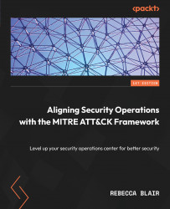
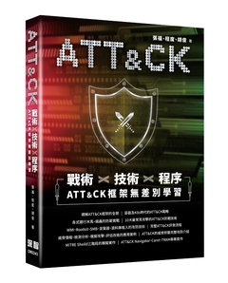
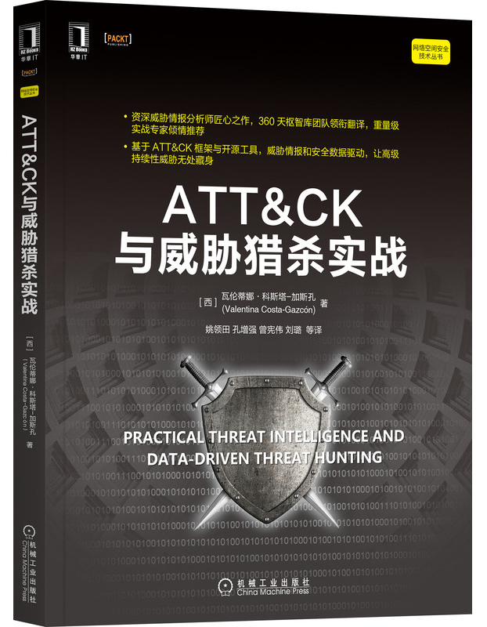
推薦閱讀
https://www.tenlong.com.tw/products/9787111703068?list_name=srh
ATT&CK 三個關鍵工具
https://www.tenlong.com.tw/products/9786267146316?list_name=srh

Slide 18
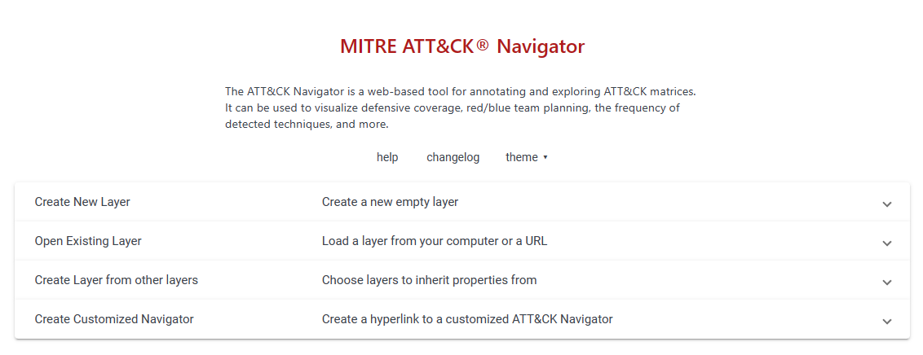
MITRE ATT&CK® Navigator
https://mitre-attack.github.io/attack-navigator/

Slide 19
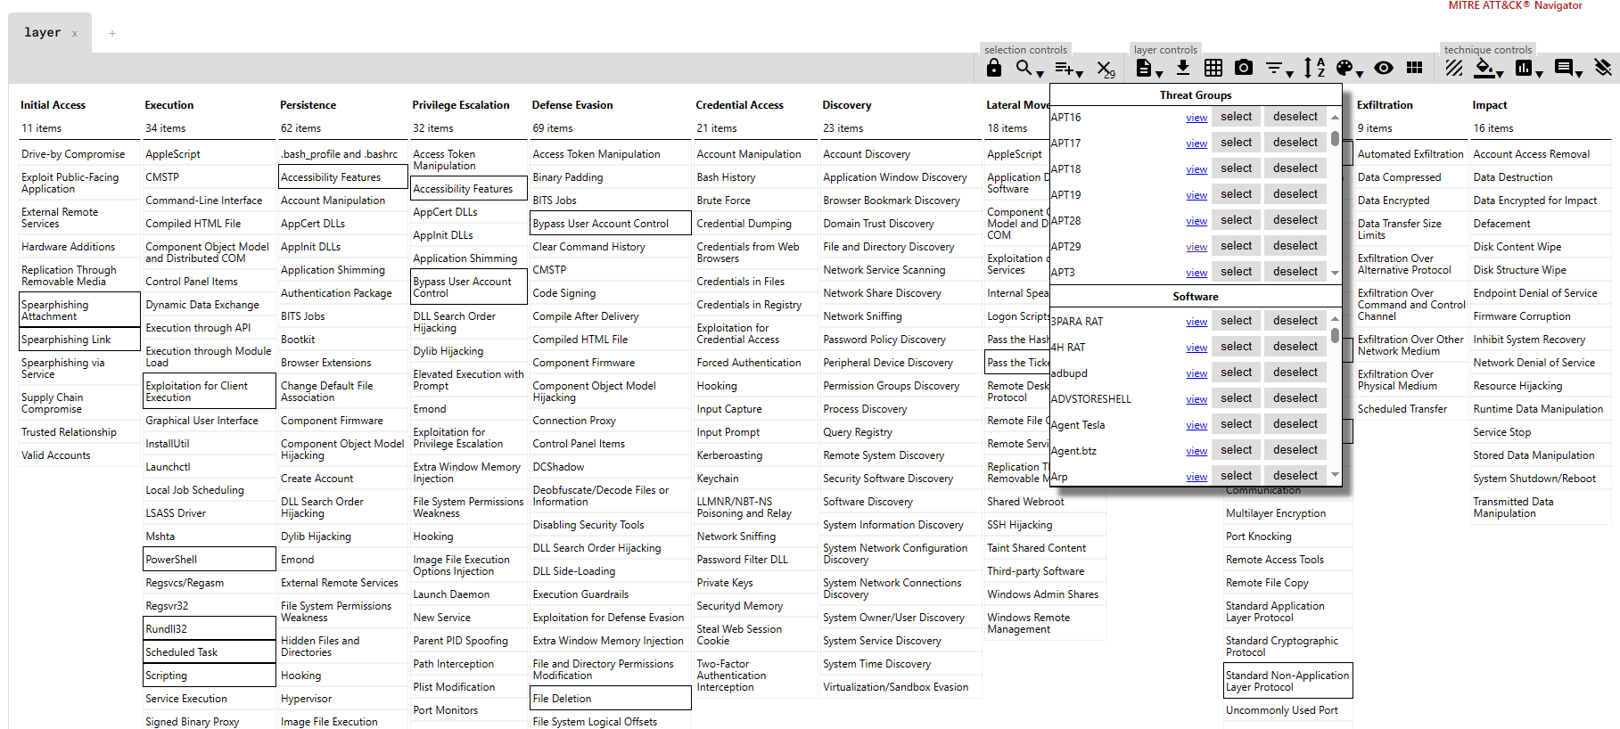

Slide 20
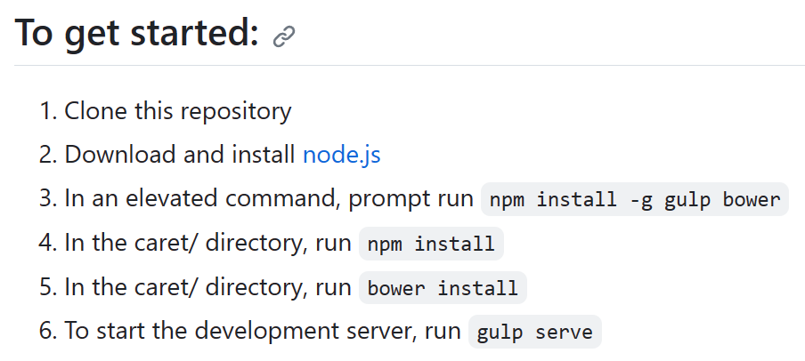
Cyber Analytic Repository Exploration Tool (CARET)
https://github.com/mitre/caret
The Cyber Analytic Repository Exploration Tool (CARET) is a proof-of-concept graphical user interface designed to connect the groups and techniques highlighted in ATT&CK™ to the analytics, data model, and sensors highlighted in MITRE's Cyber Analytics Repository (CAR). 0
CARET is used to develop an understanding of defensive capabilities and to aid in their development and use.

Slide 21
TRAM | Threat Report ATT&CK® Mapping
https://github.com/center-for-threat-informed-defense/tram/
Threat Report ATT&CK Mapper (TRAM) is an open-source platform designed to to reduce cost and increase the effectiveness of integrating ATT&CK across the CTI community.
It does this by automating the mapping of cyber threat intelligence (CTI) reports to MITRE ATT&CK®. Threat intel providers, threat intel platforms, and analysts can use TRAM to integrate ATT&CK more easily and consistently into their products.
The platform works out of the box to identify up to 50 common ATT&CK techniques in text documents;
it also supports tailoring the model by annotating additional items and rebuilding the model.
This Wiki describes the results of the Center for Threat-Informed Defense (CTID) research into automated ATT&CK mapping and provides details and instructions for tailoring the platform to your organization's unique dataset.

Slide 22
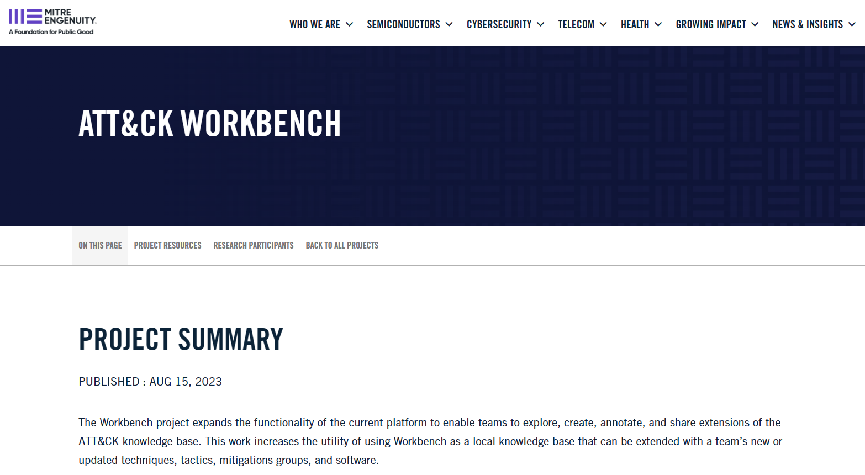
ATT&CK Workbench https://mitre-engenuity.org/cybersecurity/center-for-threat-informed-defense/our-work/attck-workbench/

Slide 23

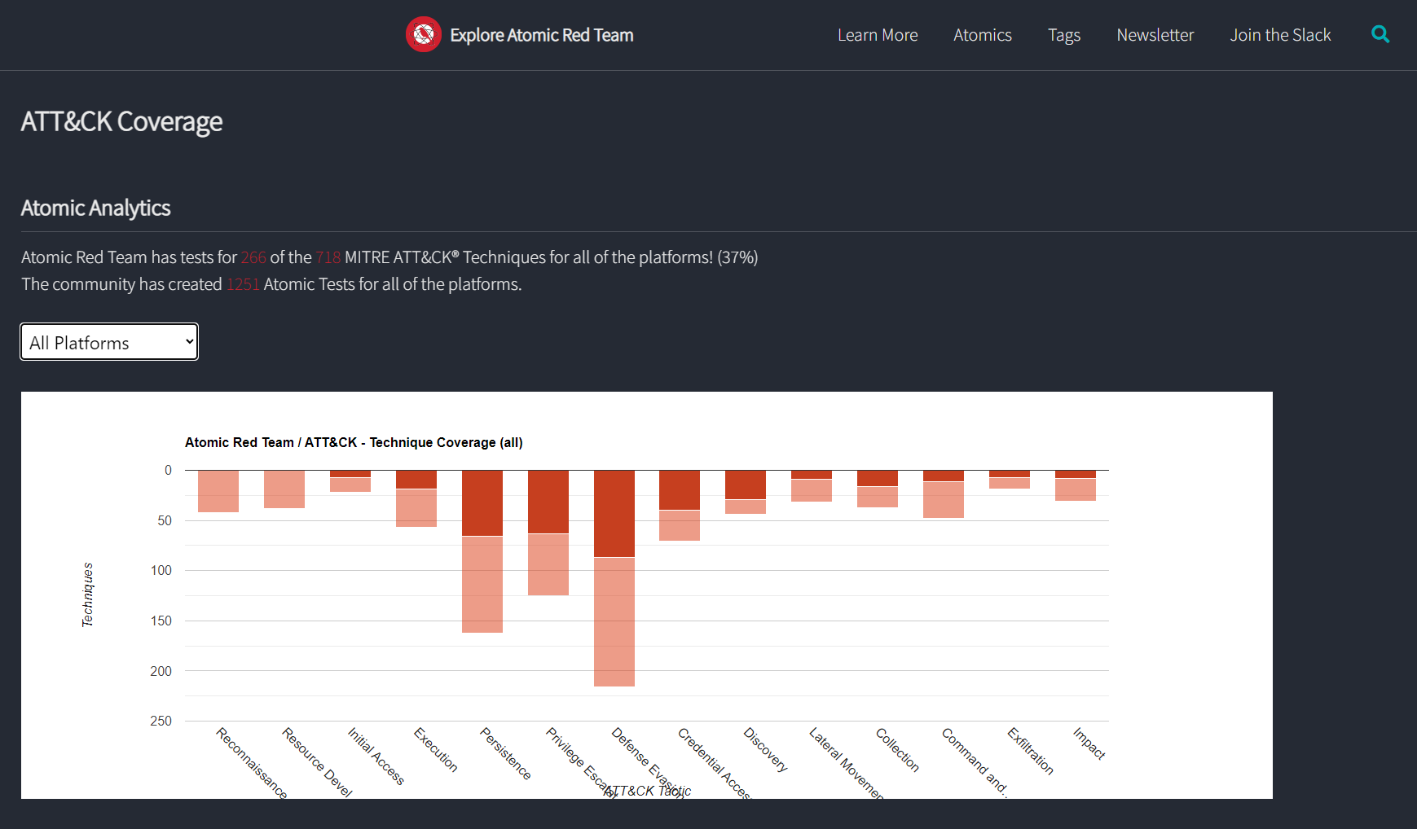
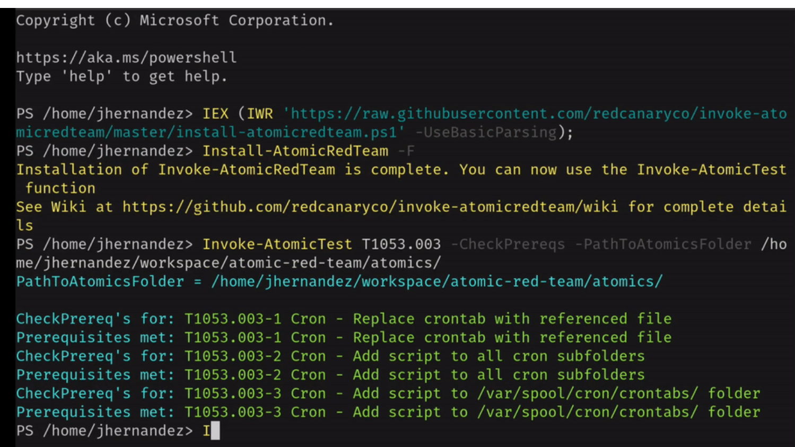
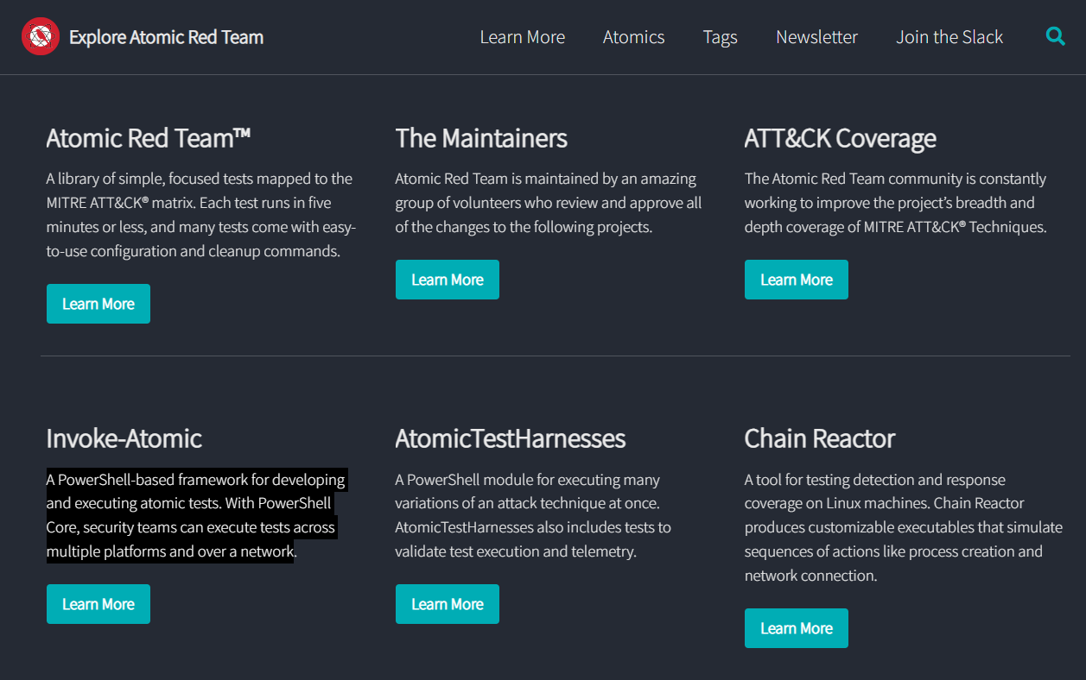
https://github.com/redcanaryco/atomic-red-team
https://atomicredteam.io/coverage/
Red Canary’s Invoke-AtomicRedTeam PowerShell Testing Framework
Atomic Red Team
Atomic Red Team™ is a library of tests mapped to the MITRE ATT&CK® framework.
Security teams can use Atomic Red Team to quickly, portably, and reproducibly test their environments.
https://github.com/redcanaryco/atomic-red-team/wiki/

Slide 24
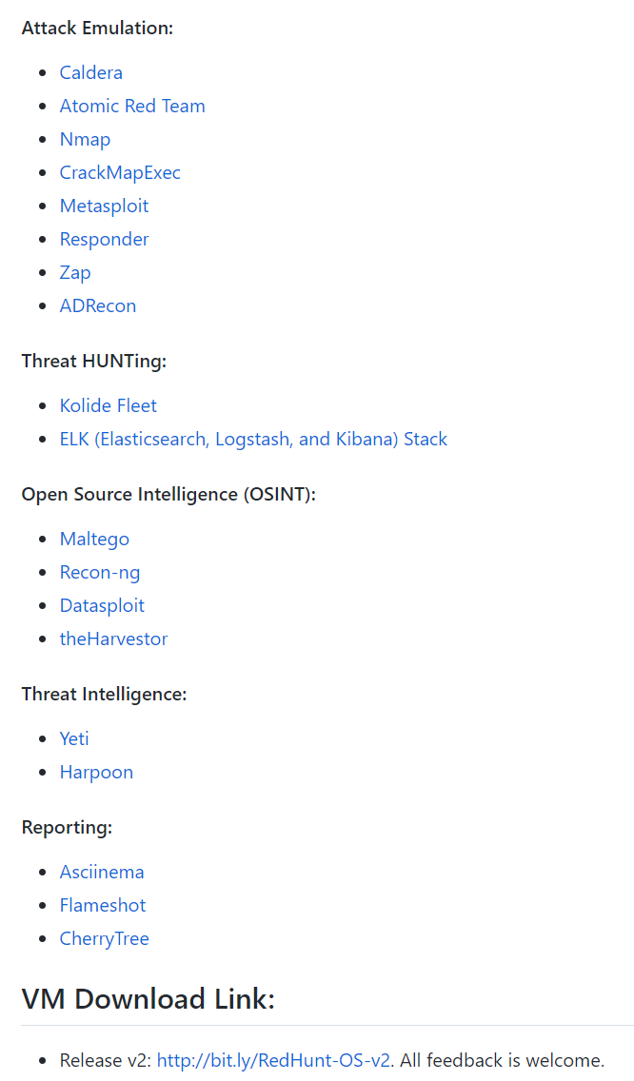

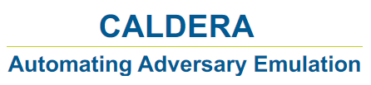

MITRE ATT&CK 自動化攻擊模擬平臺
https://github.com/redhuntlabs/RedHunt-OS
Open Source Adversary Emulation Tools:
https://pentestit.com/adversary-emulation-tools-list

Slide 25
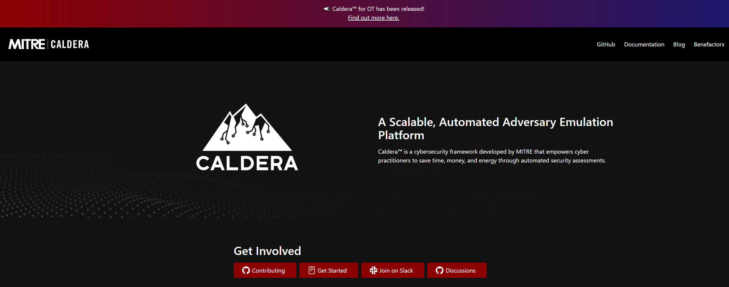
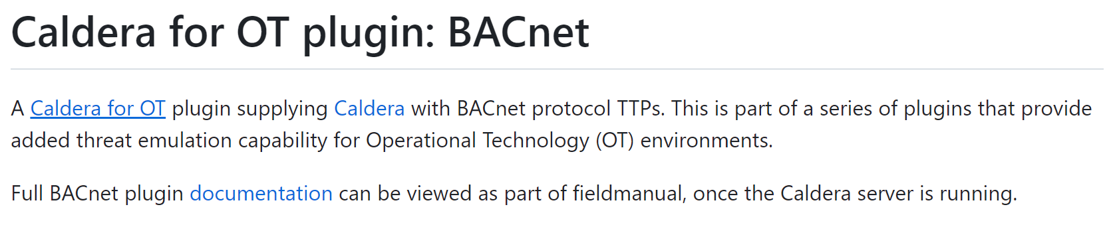
OT security
https://github.com/mitre/bacnet/tree/745432cc3aa01c8de481dec063b6ccf02f601247

Slide 26
推薦閱讀 Aligning Security Operations with the MITRE ATT&CK Framework
Part 1 – The Basics: SOC and ATT&CK, Two Worlds in a Delicate Balance
Chapter 1: SOC Basics – Structure, Personnel, Coverage, and Tools
Chapter 2: Analyzing Your Environment for Potential Pitfalls
Chapter 3: Reviewing Different Threat Models
Chapter 4: What Is the ATT&CK Framework?
Part 2 – Detection Improvements and Alignment with ATT&CK
Chapter 5: A Deep Dive into the ATT&CK Framework
Chapter 6: Strategies to Map to ATT&CK
Chapter 7: Common Mistakes with Implementation
Chapter 8: Return on Investment Detections
Part 3 – Continuous Improvement and Innovation
Chapter 9: What Happens After an Alert is Triggered?
Chapter 10: Validating Any Mappings and Detections
Chapter 11: Implementing ATT&CK in All Parts of Your SOC
Chapter 12: What’s Next? Areas for Innovation in Your SOC

Slide 27
reference

Slide 28
網路服務阻斷 Network Denial of Service
https://attack.mitre.org/techniques/T1498/
Sub-techniques (2)
ID | Name
T1498.001 | Direct Network Flood
T1498.002 | Reflection Amplification
Adversaries(攻擊者)可能會執行網路服務阻斷 (DoS) 攻擊，以降低或阻止目標資源的可用性(availability)。
網路 DoS 可以通過耗盡服務所依賴的網路帶寬來執行。
Adversaries(攻擊者)目的 == >出於政治目的和支持其他惡意活動(包括分散注意力、黑客行動主義和勒索)而進行網路 DoS 攻擊。
分佈式 DoS (DDoS) A distributed denial of service (DDoS) attack is launched from numerous compromised devices, often distributed globally in what is referred to as a botnet
執行網路 DoS 攻擊的幾個方面適用於多種方法，包括 IP 地址欺騙和殭屍網路
Adversaries(攻擊者)可能會使用攻擊系統的原始 IP 地址，或偽造源 IP 地址，使攻擊流量更難追溯到攻擊系統
ID | Name | Description
G0007 | APT28 | In 2016, APT28 conducted a distributed denial of service (DDoS) attack against the World Anti-Doping Agency.
S0532 | Lucifer | Lucifer can execute TCP, UDP, and HTTP denial of service (DoS) attacks.

Slide 29
Mitigations 緩解措施
ID | Mitigation | Description
M1037 | Filter Network Traffic | When flood volumes exceed the capacity of the network connection being targeted, it is typically necessary to intercept the incoming traffic upstream to filter out the attack traffic from the legitimate traffic. Such defenses can be provided by the hosting Internet Service Provider (ISP) or by a 3rd party such as a Content Delivery Network (CDN) or providers specializing in DoS mitigations. Depending on flood volume, on-premises filtering may be possible by blocking source addresses sourcing the attack, blocking ports that are being targeted, or blocking protocols being used for transport. As immediate response may require rapid engagement of 3rd parties, analyze the risk associated to critical resources being affected by Network DoS attacks and create a disaster recovery plan/business continuity plan to respond to incidents.
Detection偵測
ID | Data Source | Data Component | Detects
DS0029 | Network Traffic | Network Traffic Flow | Monitor network data for uncommon data flows. Processes utilizing the network that do not normally have network communication or have never been seen before are suspicious.
DS0013 | Sensor Health | Host Status | Detection of Network DoS can sometimes be achieved before the traffic volume is sufficient to cause impact to the availability of the service, but such response time typically requires very aggressive monitoring and responsiveness or services provided by an upstream network service provider. Monitor for logging, messaging, and other artifacts highlighting the health of host sensors (ex: metrics, errors, and/or exceptions from logging applications)

Slide 30
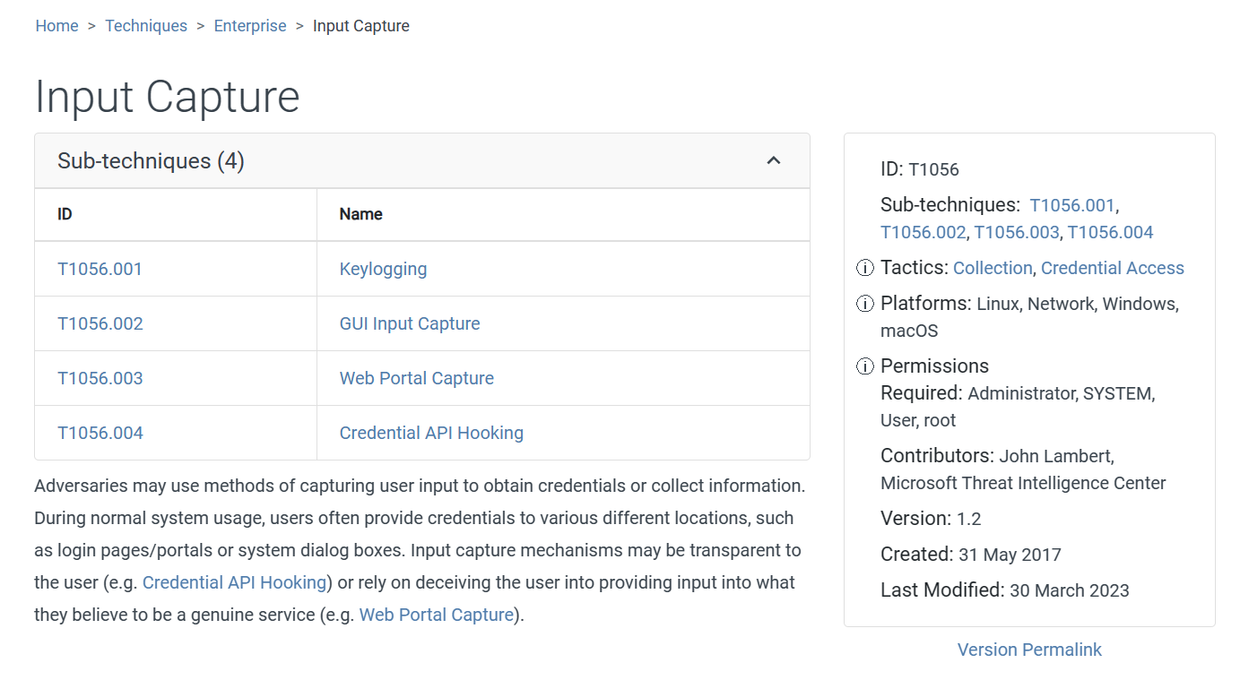

Slide 31
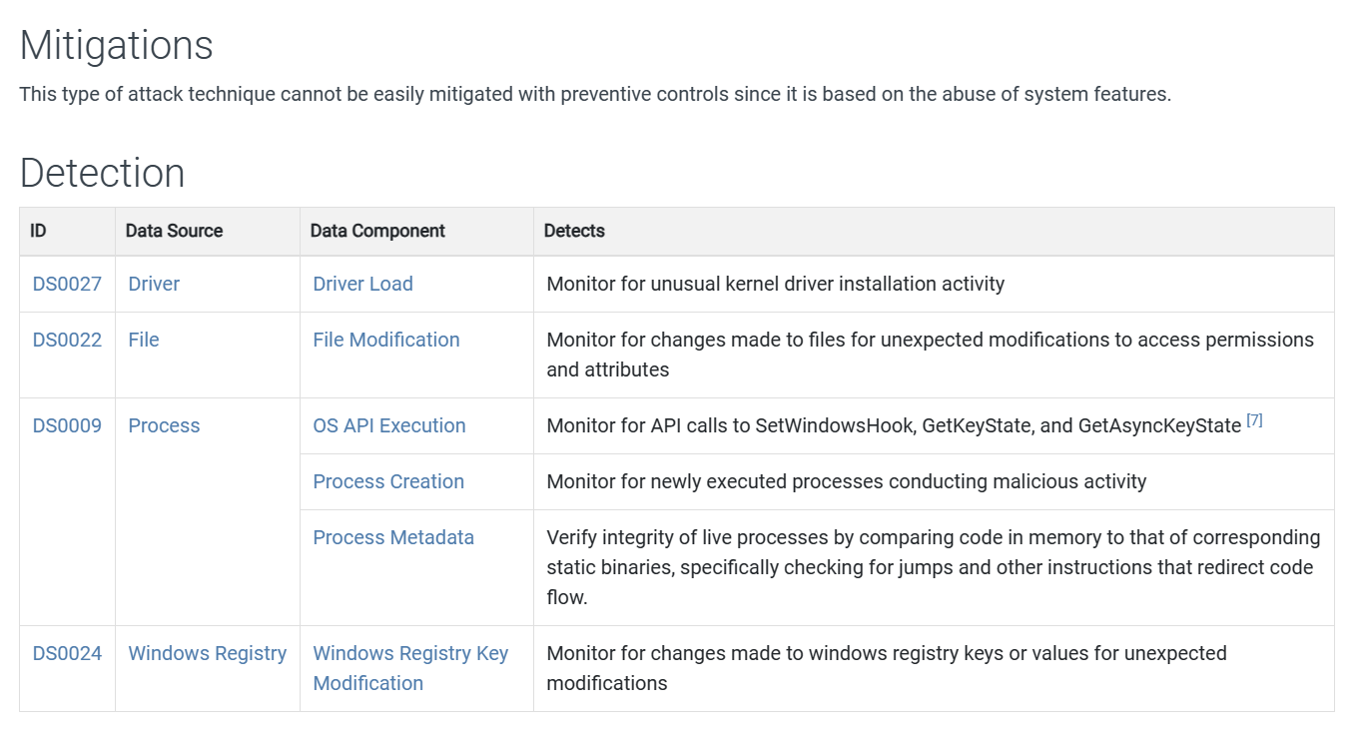

Slide 32
c | 1. | 在Cyber Kill Chain 模型中，Delivery 階段通常包括下列何項攻擊手法？ (A) 惡意軟體安裝 (B) 網站水坑攻擊 (C) 電子郵件附件或內文URL 連結 (D) 帳號密碼填充攻擊
abc | 2. | 關於MITRE ATT&CK 中的瀏覽器會話劫持（Browser SessionHijacking）技術，下列哪些正確？（複選） (A) 可透過資安認知訓練（Awareness Training）來緩解此技術 (B) 可分析登入會話（Logon Session）的產生狀態來偵測此技術 (C) 可透過使用者帳戶管理（User Account Management）來緩解此技術 (D) 僅能透過分析程序存取（Process Access）與程序修改（Process Modification）狀態來偵測此技術

